Slide 1
Sibel Ileana Okumus
Policy and Advocacy Advisor
ileana.Okumus@euase.eu
Antonin Chapelot Advocacy and Policy Lead
antonin.chapelot@energycoalition.eu

Slide 2
The time to create an energy efficient Europe is now!
European Alliance to Save Energy is a business led, cross sectoral and multi-stakeholder organization bringing together business leaders, campaigners and policy-makers promoting the role of energy efficiency across the whole EU energy system.
Our mission is to prioritize energy efficiency, promote its multiple benefits, and enhance technological solutions to drive a fast and just energy transition.
We seek to integrate energy efficiency into political agendas, increase energy security, and highlight its affordability and realistic potential in achieving a competitive and sustainable economy.

Slide 3
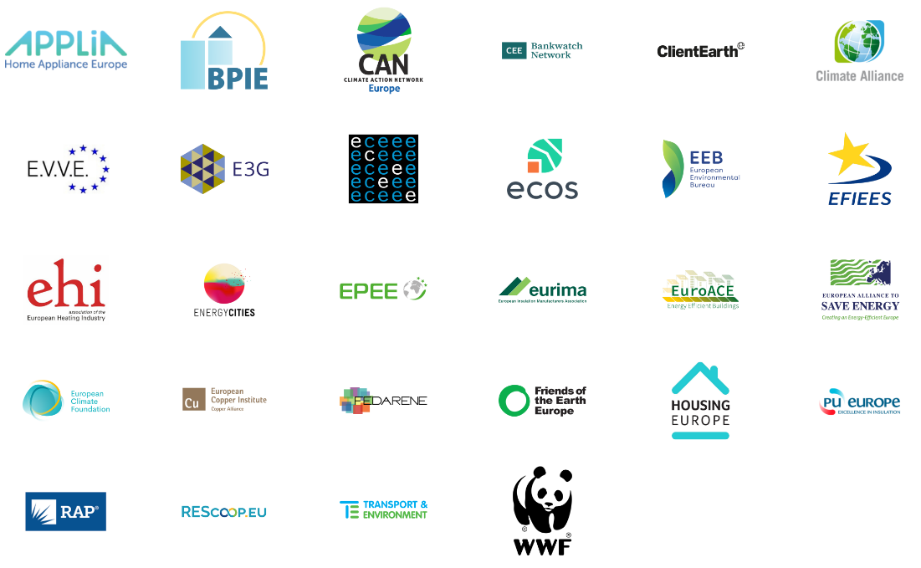
Striving to make energy efficiency & savings the first consideration of energy policy!
The Coalition unites businesses, local authorities, energy agencies, energy communities and civil society organisations in pursuit of this goal.
The Coalition for Energy Savings is a European non-for profit association striving to make energy efficiency and energy savings the first consideration of energy policies.
Joint advocacy platform to promote energy efficiency, one-stop shop for stakeholders and policy makers looking for knowledge, advice and support on energy efficiency policy and venue to share intelligence and test new ideas of the latest efficiency policy developments

Slide 4
The Importance of Energy Efficiency
According to Energy Efficiency Directive (EED), ‘energy efficiency’ means the ratio of output of performance, service, goods or energy, to input of energy.
Multiple benefits of energy efficiency:
Reducing the use of resources
Cost savings
Energy security
Economic benefits and job creation
Environmental benefits

Slide 5
The Importance of Energy Efficiency
Multiple benefits of energy efficiency:
Reducing the use of resources
Economic benefits and job creation
Energy security
Cost savings
Environmental benefits
Improving energy efficiency lowers the need to use fossil fuels and therefore is significant for fossil fuel phase out; reduces the use of water needed for energy production and accelerates renewable energy transition.

Slide 6
The Importance of Energy Efficiency
Multiple benefits of energy efficiency:
Reducing the use of resources
Environmental benefits
Cost savings
Energy security
Economic benefits and job creation
Energy production and consumption are major contributors to GHG emissions Improving energy efficiency, one can reduce the amount of energy needed for buildings, businesses and industries, thereby lowering CO2 emissions.

Slide 7
The Importance of Energy Efficiency
Multiple benefits of energy efficiency:
Reducing the use of resources
Environmental benefits
Cost savings
Energy security
Economic benefits and job creation
Energy efficiency technologies and solutions lead to significant cost savings for citizens, businesses and governments. Reducing energy consumption will result in lower energy bills and reduced operating costs. Investments in EE have a high-return on investments.

Slide 8
The Importance of Energy Efficiency
Multiple benefits of energy efficiency:
Reducing the use of resources
Environmental benefits
Cost savings
Energy security
Economic benefits and job creation
Improving energy efficiency reduces dependence on imported energy resources and increases energy security. Reducing energy consumption lowers the risk of supply disruptions, price fluctuations, and geopolitical risks associated with energy imports.

Slide 9
The Importance of Energy Efficiency
Multiple benefits of energy efficiency:
Reducing the use of resources
Environmental benefits
Cost savings
Energy security
Economic benefits and job creation
Investments in energy efficiency technologies and solutions, manufacturing and service sectors will generate employment opportunities.

Slide 10
Energy Efficiency First Principle
According to European Commission, the “energy efficiency first principle” means taking utmost account of cost-efficient energy efficiency measures in shaping energy policy and making relevant investment decisions.
EE1st principle is one of the key pillar of EU`s energy union and an essential approach to achieve climate targets and reduce dependence on fossil fuel.

Slide 11
Our Key Focus Areas
Energy Efficiency Directive (EED)
Key legislation setting the overall framework to deliver energy savings across the European Union.
Sets the energy efficiency target for the EU (2020 and 2030) which is how much energy must be consumed at these dates.
Also sets specific measures (public sector, energy audits, amount of energy to be saved each year in every EU countries).
New EED approved in March 2023, focus is now on the implementation of the new requirements.

Slide 12
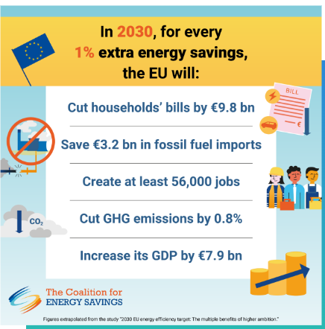
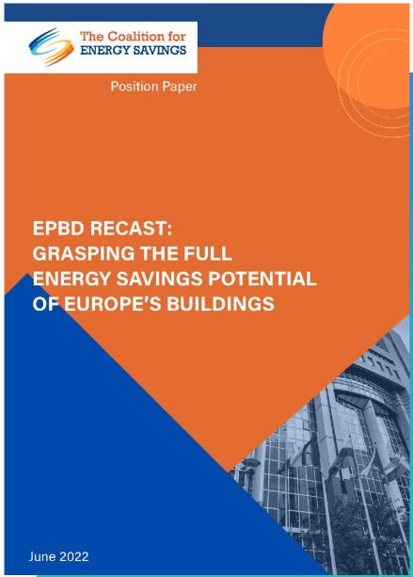
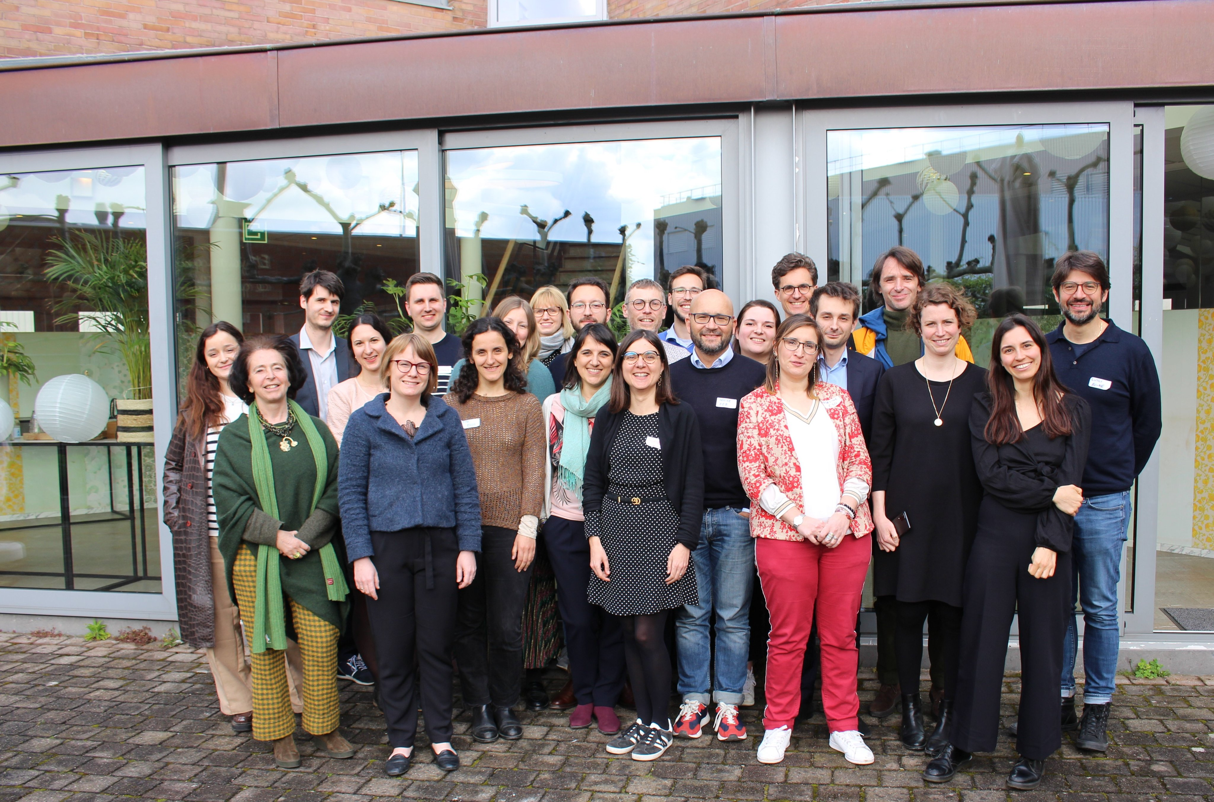
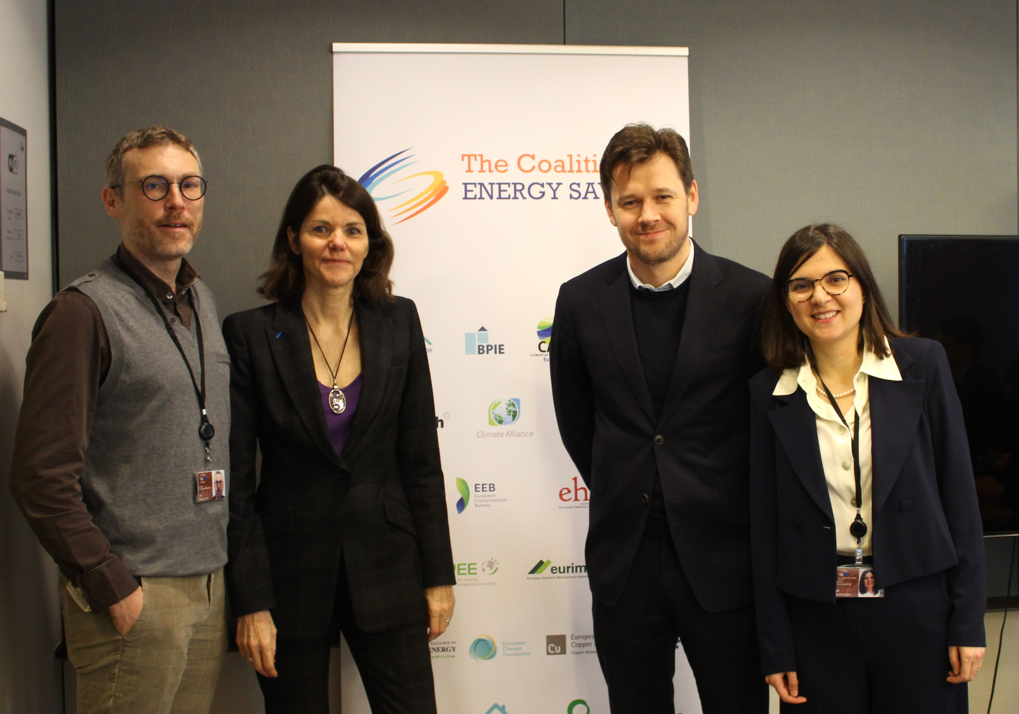
What Do We do?

Slide 13
Our Key Focus Areas
Energy Performance of Buildings Directive (EPBD)
Revision of EPBD was presented as one of the key initiatives of Renovation strategy, which is part of the European Green Deal.
Buildings are responsible for approximately;
40% of EU`s total energy consumption
36% of the energy-related greenhouse gas emissions
8% of the EU population are in energy poverty
75% of the buildings in the EU are energy inefficient
The European Parliament and the European Commission proposes to gradually increase energy performance of the buildings, starting with the worst performing buildings, with the aim to achieve net-zero emissions by 2050, reduce the energy need of the buildings and therefore reduce energy bills
Reducing energy demand of buildings through renovations by 80% by 2050 will save 30% of the total energy use in the EU
State of play:
EPBD is now under negotiation. Trilogues started by the end of Swedish presidency and now continuing under Spanish presidency

Slide 14
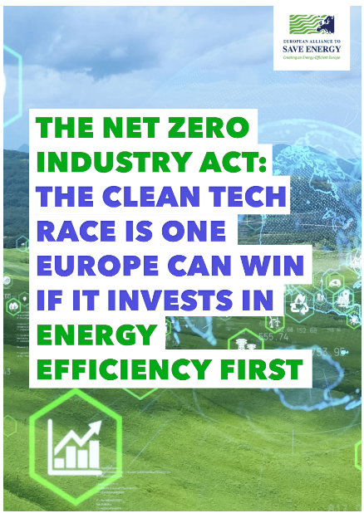
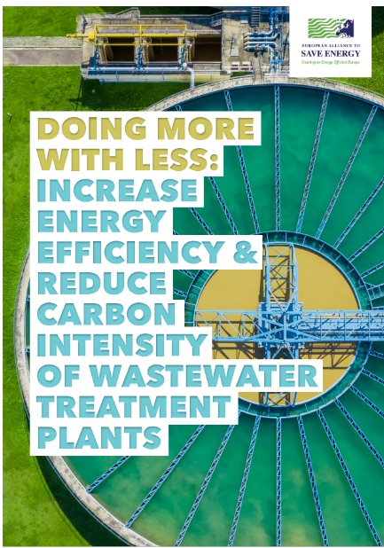
What Do We Do?

Slide 15
Thank You

